Slide 1
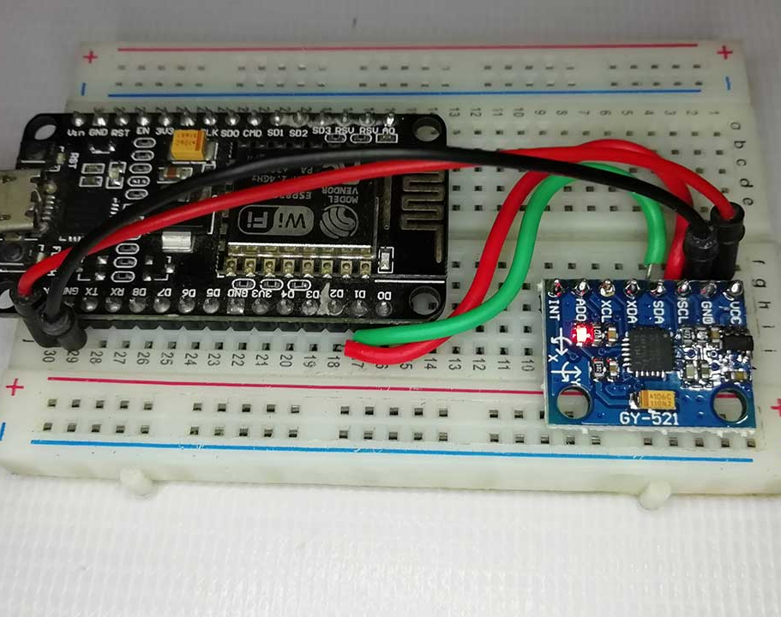
LANGUAGE DETECTION MODEL (using NLP)
IoT BASED-FALL DETECTION SYSTEM USING NODE MCU ESP 32 & MPU 6050
Batch No: 04
1. 22071A6915 – E.Madhuri
2. 22071A6918 – K.Geethika
3. 22071A6936 - K.Abhi Sree
4. 22071A6949 - Danny
Batch 04: 1.22071A6915-E.Madhuri
2.22071A6918-K.Geethika
3.22071A6936-K.Abhi Sree
4.22071A6949-Danny
Name of the Guide:Dr K.Archana
Designation:Asst.Proffessor
Institution:VNRVJIET

Slide 2
ABSTRACT
The increasing incidence of falls, particularly among elderly individuals and patients with mobility impairments, necessitates the development of an efficient and reliable fall detection system. This project proposes a Wearable Fall Detection System utilizing the ESP32 microcontroller and the MPU6050 sensor, integrated with the Blynk IoT platform for real-time monitoring and alert notifications. The system captures motion data through the accelerometer and gyroscope, processes it on the ESP32, and determines whether a fall has occurred. Upon detection, an alert is transmitted to the Blynk cloud, triggering push notifications and email alerts to caregivers or healthcare providers. The system offers continuous monitoring, remote accessibility, and customizable sensitivity settings, ensuring an efficient and user-friendly approach to fall detection. This paper discusses the design, implementation, and performance analysis of the proposed system, highlighting its advantages over traditional fall detection methods.

Slide 3
INTRODUCTION
Falls represent a significant health concern, especially among the elderly population, with potentially severe consequences such as fractures, head injuries, and even death. According to the World Health Organization (WHO), approximately 28-35% of individuals aged 65 and older experience a fall each year, with this number increasing as individuals age. Falls are the leading cause of injury-related deaths in this demographic and are frequently associated with a decline in quality of life, higher healthcare costs, and reduced independence. In fact, studies indicate that one in every three seniors over the age of 65 experiences at least one fall annually, and the frequency of falls rises with advancing age.
Traditional fall detection methods, including manual observation and camera-based surveillance, pose challenges related to privacy, accessibility, and real-time response. Recent advancements in wearable technology and Internet of Things (IoT) solutions have enabled the development of automated fall detection systems, which can instantly notify caregivers upon detecting an incident.
This project introduces a Fall Detection System based on ESP32, an energy-efficient microcontroller with built-in Wi-Fi, and the MPU6050 sensor, which combines an accelerometer and gyroscope for motion tracking. The system continuously monitors movement patterns, detects falls using predefined thresholds, and transmits alerts via Blynk cloud to notify healthcare providers. The use of wireless connectivity enables real-time monitoring, allowing caregivers to view fall history, adjust sensitivity, and respond promptly to emergencies.

Slide 4
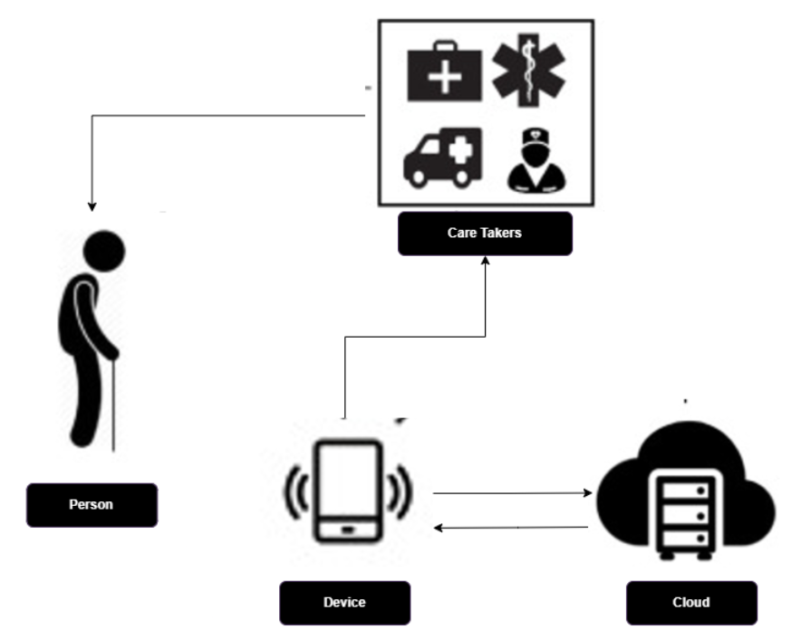
INTRODUCTION

Slide 5
Technology Used
1. Hardware Components
a. Microcontroller & Sensors
ESP32
Wi-Fi & Bluetooth connectivity
520 KB SRAM, 4MB Flash
Multiple GPIOs for sensor interfacing
Low power consumption
MPU6050 (IMU Sensor - Accelerometer & Gyroscope)
3-axis accelerometer & 3-axis gyroscope
I2C interface for communication with ESP32
Built-in digital motion processing
b. Power Supply
Powered directly via USB or onboard ESP32 power
management
c. Communication Modules
Wi-Fi (via ESP32) for Cloud Data Transmission
2. Software & Algorithms
a. Firmware Development
Programming Language: C/C++ (Arduino IDE)
IDE: Arduino IDE
Communication Protocols: I2C (MPU6050), HTTP (Blynk)
b. Fall Detection Algorithm
Raw Data Processing (Acceleration & Gyro Data from MPU6050)
Threshold-based Detection
If acceleration exceeds a predefined threshold (e.g., >2g), a fall is suspected
Further verification using angular velocity
3. Cloud & Connectivity
a. Cloud Integration
Blynk for real-time data storage and monitoring
HTTP-based data transmission
Emergency alert notifications via Blynk notifications

Slide 6
Literature Survey
SNO | TITLE OF THE PAPER | TITLE OF THE JOURNAL | REFERENCE WITH DOI | PROBLEMS OR GAP ADDRESSED | OBJECTIVE OF THE PAPER | FOCUS OF THE PAPER | SUMMARY
1 | Fall Detection and Prevention for the Elderly: A Review of Trends and Challenges | International Journal on Smart Sensing and Intelligent Systems, Vol. 6, No. 3, June 2013 | https://www.researchgate.net/publication/286157322_Fall_detection_and_prevention_for_the_elderly_A_review_of_trends_and_challenges | The paper highlights the increasing risk of falls among elderly individuals, which can lead to severe injuries, reduced mobility, and increased healthcare costs. It identifies the challenges in existing fall detection and prevention technologies, such as high false alarm rates in camera-based systems, | The paper aims to present a comprehensive review of current trends and technologies for fall detection and prevention among the elderly. It evaluates the effectiveness of existing solutions | The study focuses on different methodologies for fall detection and prevention, including wearable sensors, vision-based systems, accelerometers, and artificial intelligence techniques. It also explores emerging trends in multi-sensor data fusion. | The paper provides an extensive review of state-of-the-art research and commercial solutions for elderly fall detection and prevention. It discusses various causes and consequences of falls, surveys different detection techniques, and highlights the limitations of current technologies.

Slide 7
2 | Falls in Older People: Risk Factors and Strategies for Prevention (2nd edn) | Australasian Journal on Ageing, Vol 28 No 1, March 2009 | https://onlinelibrary.wiley.com/doi/full/10.1111/j.1741-6612.2009.00347.x?msockid=0949a442706a61b91d28b14c71bf6022 | The paper highlights the increasing risk of falls among older adults and their serious health consequences. It identifies the need for improved fall prevention strategies, particularly for individuals who lie for long periods after falling, as they have a significantly higher risk of poor recovery and mortality. The book reviews previous research and assesses gaps in identifying and addressing risk factors. | The paper aims to provide an updated review of research on fall prevention strategies, including newly published studies. It seeks to identify key risk factors associated with falls in older people and evaluate the effectiveness of various interventions, such as exercise programs, balance training, and medical interventions like cataract removal. | The study focuses on assessing fall risk factors, prevention strategies, and the effectiveness of interventions to reduce fall-related injuries. It discusses the role of physical and medical conditions, environmental factors, and behavioral aspects in fall prevention. | The paper provides a comprehensive review of fall risk factors and prevention strategies for older adults. It presents data from various studies and highlights the increasing research attention on fall prevention. The authors analyze different approaches, including exercise programs.

Slide 8
3 | The Methods of Fall Detection: A Literature Review | Sensors 2023, 23, 5212 | https://www.mdpi.com/1424-8220/23/11/5212 | The paper highlights the challenges in existing fall detection systems, including accuracy issues, high false alarm rates, and privacy concerns. It also identifies gaps in the integration of IoT, cloud computing, and machine learning for real-time fall detection. The review underscores the need for improved algorithms, better dataset availability, and enhanced security measures. | The main objective of the paper is to review and categorize different fall detection methods, evaluate their effectiveness, and identify areas for improvement. It aims to provide insights into sensor-based, vision-based, IoT-based, and machine learning-driven fall detection strategies. | The paper focuses on various fall detection strategies, including wearable sensor-based methods, vision-based techniques, smartphone applications, and cloud-based detection systems. | The paper provides a comprehensive literature review on fall detection methods, discussing their strengths, limitations, and future potential. It explores different sensor-based and vision-based techniques, the role of IoT and cloud computing, and the impact of machine learning algorithms.

Slide 9
4 | Comparative Study on Performance of ML Models for Fall Detection in Older People | Preprints.org (Not Peer-Reviewed) | https://www.preprints.org/manuscript/202312.2027/ | The paper identifies several key gaps in fall detection research, including misleading performance metrics due to imbalanced datasets, inaccurate data segmentation in existing fall datasets, and the need for time-series windowing to improve real-time detection accuracy. It highlights that most studies have not conducted a thorough comparative analysis of traditional and deep learning models for fall detection | The study aims to systematically evaluate and compare the performance of standard machine learning (ML) models for fall detection using the SisFall dataset. It seeks to establish a robust methodology for data processing, training, and evaluation of ML models to improve fall detection accuracy in elderly individuals. | The paper focuses on developing a standardized pipeline for pre-processing, training, and evaluating ML models for fall detection. It compares traditional ML models (Logistic Regression, Decision Tree, Random Forest, K-Nearest Neighbors) with deep learning models | The study provides a detailed evaluation of ML models for fall detection, using a standardized approach to handle data from the SisFall dataset. It finds that deep learning models, particularly CNN+MLP, outperform traditional ML models in detecting falls.

Slide 10
5 | IoT-Based Human Fall Detection System | Electronics 2022, 11, 592 | https://www.mdpi.com/2079-9292/11/4/592 | The paper highlights the challenges of fall detection among elderly individuals, particularly the limitations of wearable solutions that require user compliance and maintenance. It addresses gaps in real-time, non-intrusive fall detection systems by proposing a non-wearable IoT-based approach. The study also explores the need for a robust classification system that minimizes false negatives, ensuring that all falls are detected accurately. | The study aims to develop and evaluate a non-wearable, IoT-based fall detection system using a three-layered computation architecture (edge, fog, and cloud). It compares two classification models—one based on Morlet wavelet analysis and the other using artificial neural networks (ANN) | The research focuses on designing and implementing an IoT-based fall detection system that is non-intrusive and deployable in various environments, including homes and healthcare facilities. It emphasizes the use of real-time data processing, artificial intelligence, and mathematical modeling to improve fall detection accuracy. | The paper presents an IoT-based system for human fall detection that utilizes sensors installed in indoor environments to monitor movement and detect falls. It introduces a multi-layered processing architecture (edge, fog, and cloud) to enhance data processing and classification efficiency.

Slide 11
Summary of literature survey
Sensor-Based Methods: Threshold-based tri-axial accelerometers detect falls with moderate accuracy but lack orientation tracking.
Combined Sensor Models: Studies suggest combining accelerometers and gyroscopes for improved accuracy.
Vision-Based Systems: Offer high precision but raise privacy concerns and require costly infrastructure.
IoT Integration: Recent work using ESP32 with real-time alerts via IoT platforms shows promise for low-cost healthcare solutions.
Conclusion: The evolution highlights the shift from simple sensors to integrated, smart systems—laying the foundation for this project.

Slide 12
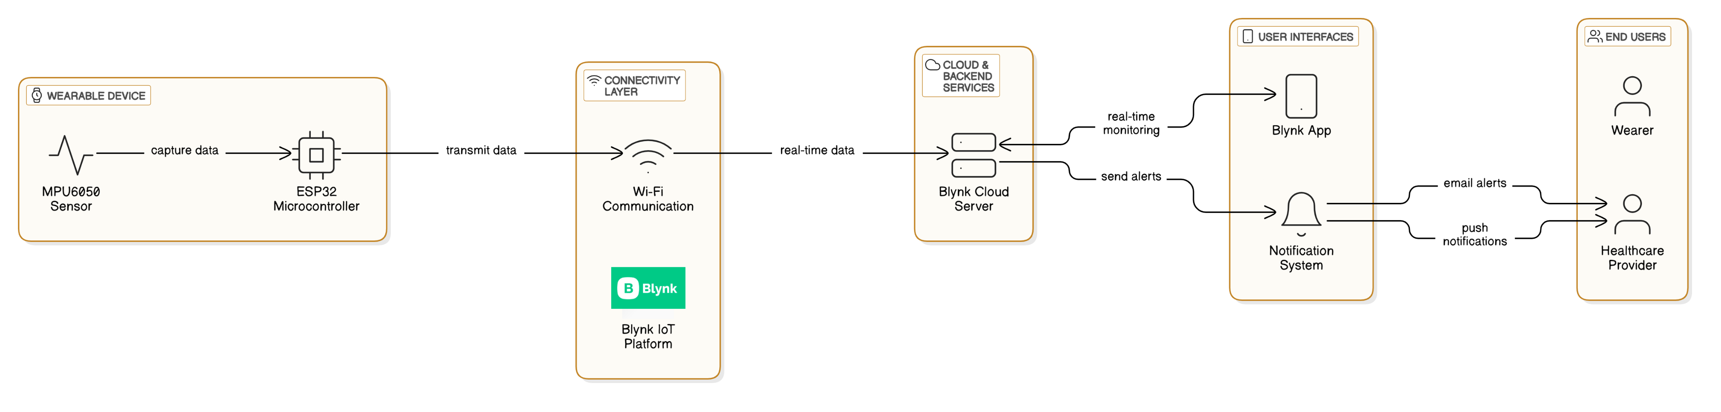
System Architecture

Slide 13
IMPLEMENTATION
Sensor Initialization:
Calibrate MPU6050 for accurate motion detection
I2C communication setup between ESP32 and sensor
Data Acquisition & Processing:
Real-time accelerometer and gyroscope data
Digital filtering to reduce noise
Buffer to store motion history
Fall Detection Logic:
Threshold-based analysis for sudden changes in motion
Detection of impact and post-impact inactivity
State Machine Implementation:
Transitions between NORMAL, POSSIBLE_FALL, IMPACT_DETECTED, etc.
Alert System:
Confirmed falls trigger notifications via Blynk app

Slide 14
Results
Performance Evaluation:
System tested with simulated falls (forward, backward, side) vs daily activities
Accuracy:
High accuracy in fall detection using threshold + gyroscope data
Effective in minimizing false positives
Response Time:
Real-time alert sent within seconds of confirmed fall

Slide 15
Analysis and Comparative Study
With Traditional Methods:
Vision-based: Higher accuracy, but privacy issues
Manual alert systems: Delay in emergency response
Compared to Past Sensor Models:
Improved accuracy due to combination of linear & angular data
Better classification with state-machine logic
Advantages:
Cost-effective
Portable and easy to implement
Scalable for healthcare institutions

Slide 16
Conclusion and Future Work
Conclusion:
The proposed IoT-based system effectively detects falls using ESP32 and MPU6050
Real-time alerts enhance caregiver response
Low-cost and energy-efficient design
Future Work:
Integration with cloud storage for historical data
Machine learning algorithms to reduce false positives
Expansion into wearable form factors (e.g., wristbands)
Voice or camera integration for verification

Slide 17
Thank you!!!

